Slide 1
Garbage Surveillance Robot
Project by :
Aashirwad N. B. (01FB14EEE004)
Kavin Nishanth (01FB14EEE0
Koustav Mandal (01FB14EEE038)
Guide: Dr. M. J. Venkatarangan

Slide 2
Problem Statement
To search for garbage sites in the PES campus and alert the house-keeping authorities.

Slide 3
Possible Solutions
1. Install cameras at multiple locations
2. Manual cleaning and surveillance
3. Design a drone to survey the campus
4. Design a mobile robot to patrol the campus.

Slide 4
WHY the Mobile Robot ?
Using multiple cameras can be costly
Manual cleaning may not be effective or hygienic
Drones can trespass privacy

Slide 5
Challenges
Rain water can harm components of the device
Complex terrain can affect the mobility of device
Battery drainage
Possible damage due to human intervention
5. Range and wireless communication

Slide 6
Methodology
Study and selection phase
Chalk down the high level requirements for the project and list down test cases
Design phase
Define the system architecture for the robot – mechanical, electrical and software
Design the algorithms used to learn and retrace the path and to detect garbage

Slide 7
3. Implementation phase
Implement the subsystems involved
Implement the algorithms on a test robot
4. System Testing phase
Integrate all the subsystems of the project
Implement the algorithms on the designed robot

Slide 8
5. Field Testing phase
Test the working of the prototype under different simulated and real world conditions

Slide 9
Timeline of project

Slide 10
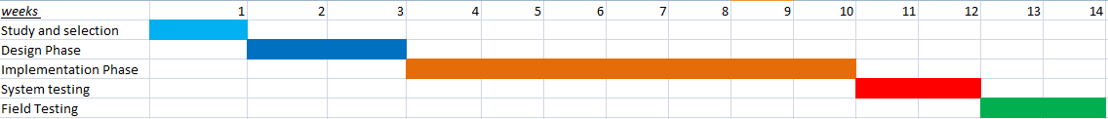
Timeline of project

Slide 11
Specifications
Expected operating time of the robot: 1 to 2 hours
Speed of the robot: ~30 cm/s

Slide 12
Relevance to Society
The relevance is very high in India as accumulated garbage is unattended for many days, leading to diseases.
It will also be a good framework for learn-and-repeat robot applications (For example, transporting memos in a bank).

Slide 13
References
C. Sprunk, G. D. Tipaldi, A. Cherubini, and W. Burgard, “Lidar-based
teach-and-repeat of mobile robot trajectories,” in Proc. of the IEEE/RSJ
Intl. Conf. on Intelligent Robots and Systems (IROS), 2013.
Alvaro Salmador, Javier Pérez Cid, Ignacio Rodríguez Novelle, “Intelligent Garbage
Classifier”, International Journal of Interactive Multimedia and Artificial Intelligence, 1.

Slide 14
THANK YOU

